Slide 1
An Efficient Scheme to Obtain Background Image in Video for YOLO-based Static Object Recognition
CS512 Final Project Presentation
Kadhiravan Gopal | Mukesh Siva

Slide 2
1. Problem Statement
• Traditional YOLO object detection struggles with static object recognition when moving objects occlude the background.
• Dynamic backgrounds, lighting fluctuations, and scene clutter cause false detections and missed objects.
• The aim is to extract a clean background using histogram-based analysis and apply YOLO on this refined image.
• Result: Improved detection of static objects in complex scenes.

Slide 3
2. Steps to follow
Video Input →
Frame Extraction →
Frame Buffering →
Histogram Analysis →
Background Estimation →
YOLO Detection →
Metric Evaluation

Slide 4
3. Dataset: CDNet2014
• Public benchmark dataset for background subtraction and change detection.
• Sequences used:
- Skating (badWeather), Fall, Fountain01 (dynamicBackground)
- Backdoor, Bungalows (shadow)
• Ground truth provided as pixel-wise masks for evaluation.
• Used to generate bounding boxes and compute detection metrics.

Slide 5
4. Proposed Solution
• Estimate background using temporal histograms of pixel values.
• Original version used grayscale histograms.
• Improved version used RGB histograms with dynamic thresholds.
• Run YOLOv3 on estimated background to detect static objects with higher precision.

Slide 6
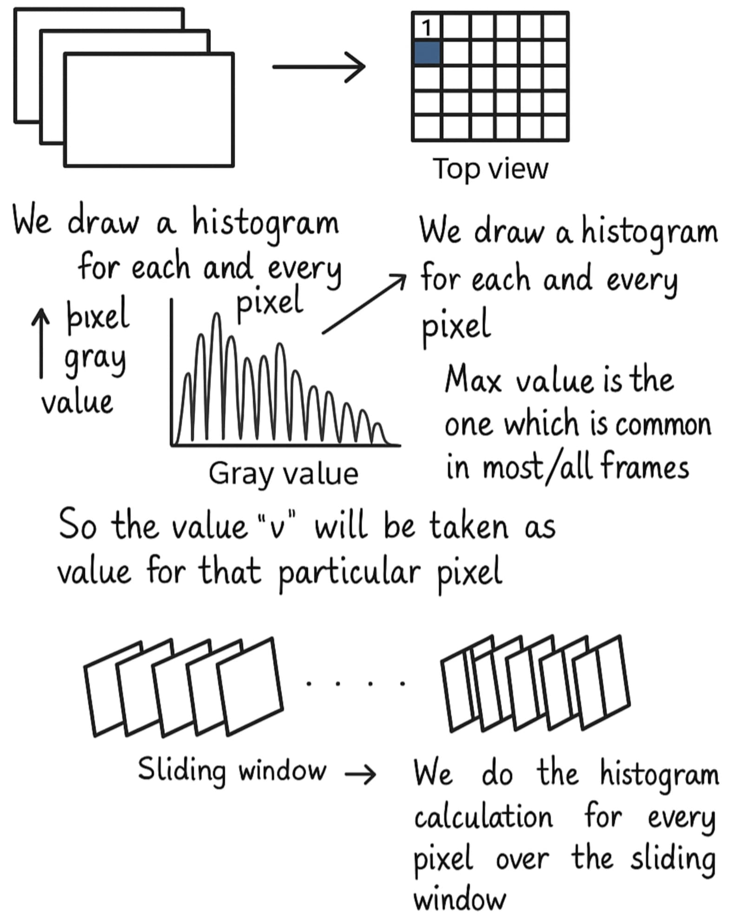
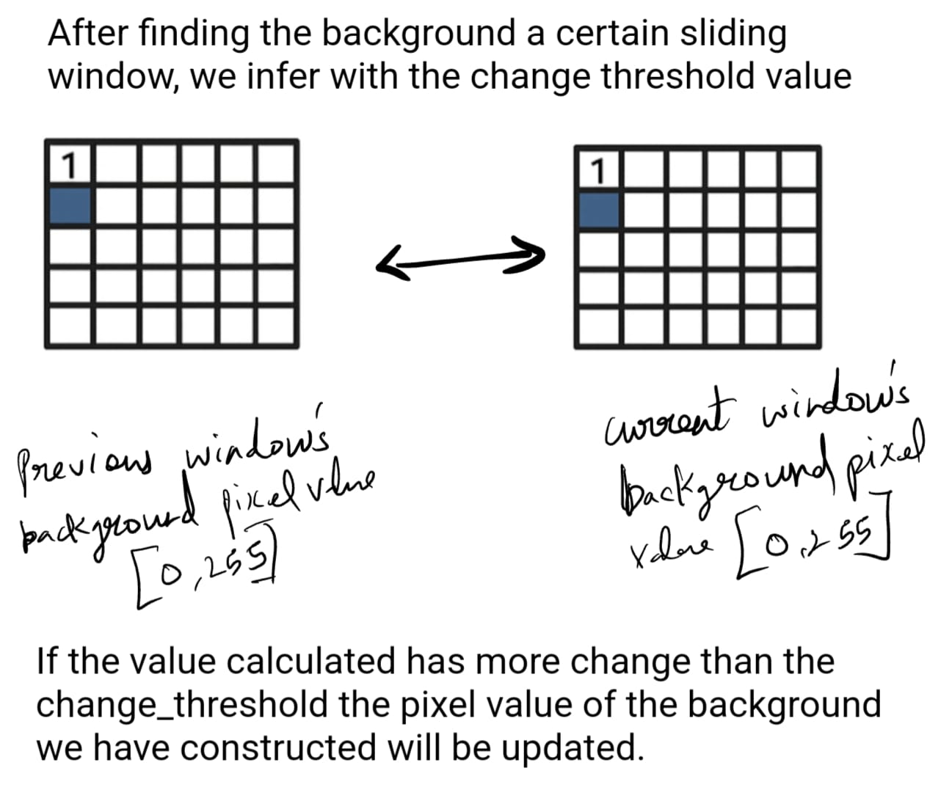
4. Histogram Analysis

Slide 7
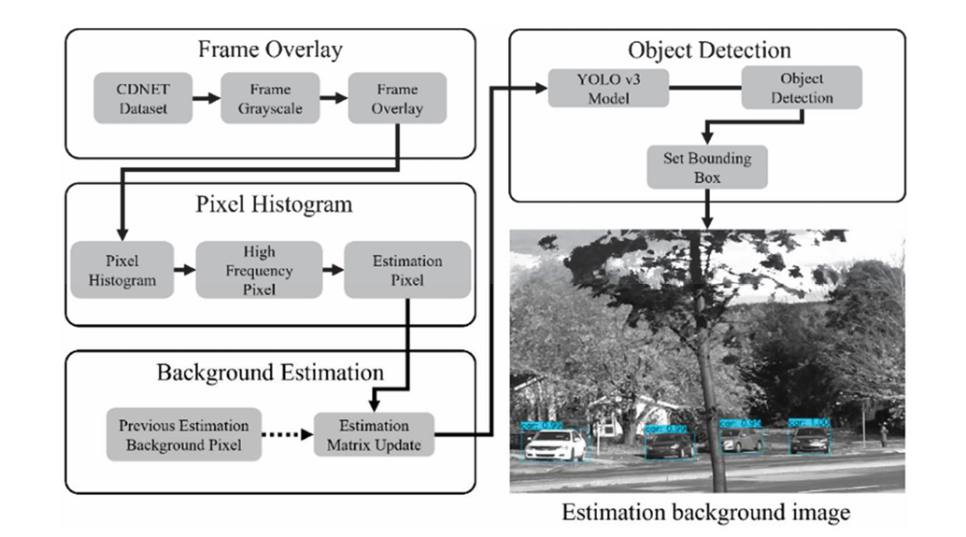
5. Background Estimation Logic

Slide 8
6.Pseudocode

Slide 9
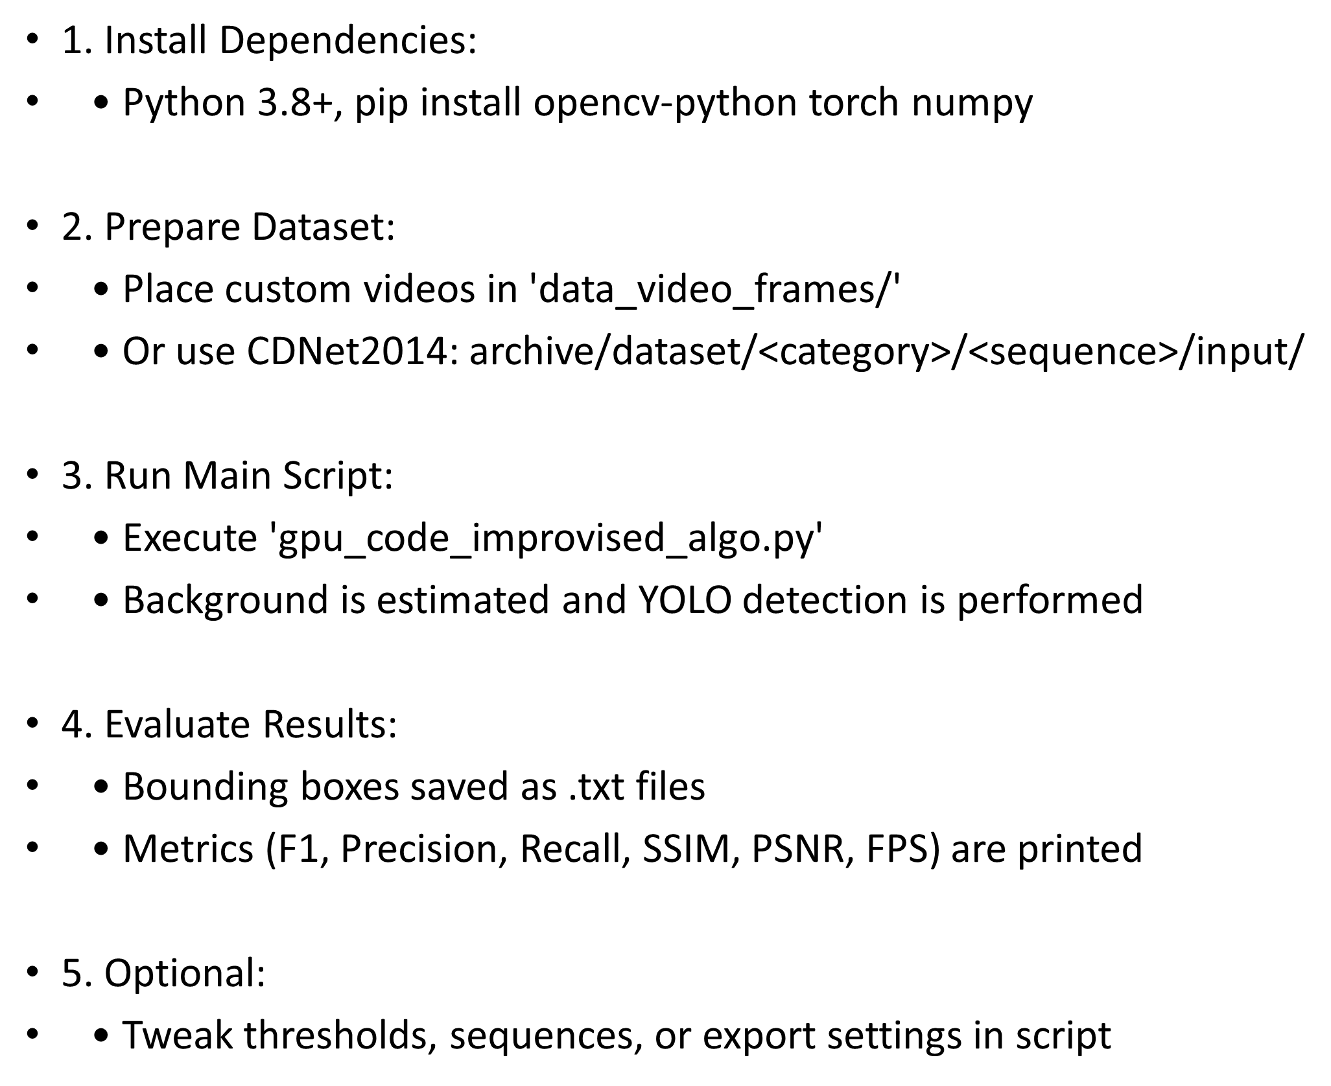
7. Implementation

Slide 10
8. Evaluation Metrics
• F1 Score = 2 × (Precision × Recall) / (Precision + Recall)
• Precision = TP / (TP + FP)
• Recall = TP / (TP + FN)
• SSIM (Structural Similarity Index)
• PSNR (Peak Signal-to-Noise Ratio)
• FPS (Frames per second)

Slide 11
9. Results Summary (RGB vs Grayscale)
• RGB algorithm improved F1 Score by up to 20%.
• SSIM consistently > 0.85, PSNR 25–27 dB.
• FPS dropped slightly (~2–4 FPS) but still real-time (>17 FPS).
• Significant gains in object detection precision and robustness.

Slide 12
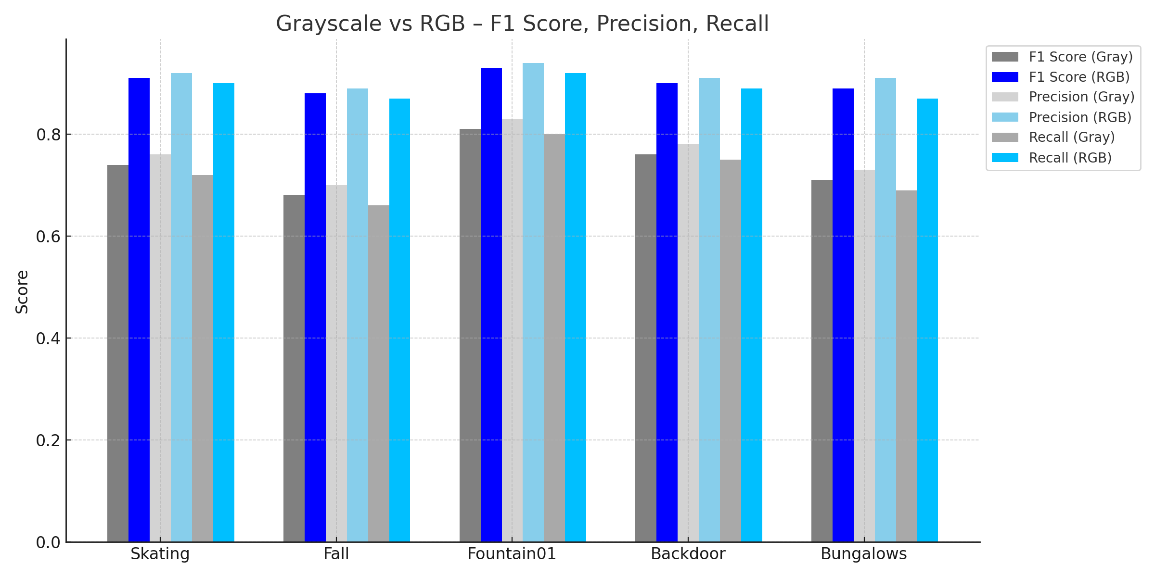
10. Quantitative Comparison: Grayscale vs RGB

Slide 13
11. Background Quality Metrics

Slide 14
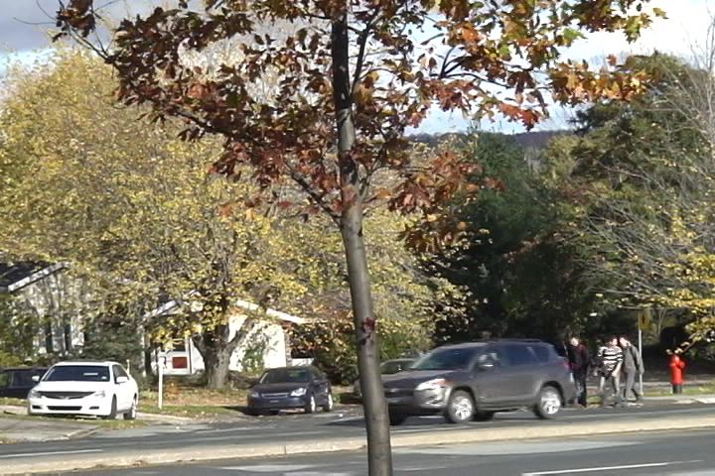
12. Visual Comparison
• Figure 1: Input frame (with occlusion)

Slide 15
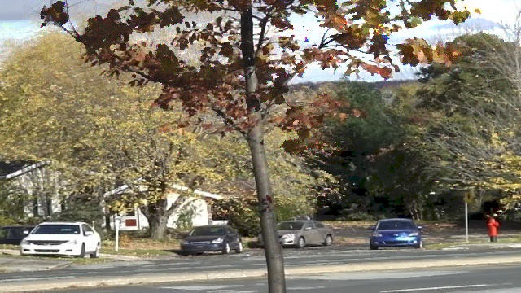
12. Visual Comparison
• Figure 2: Estimated background (RGB)

Slide 16
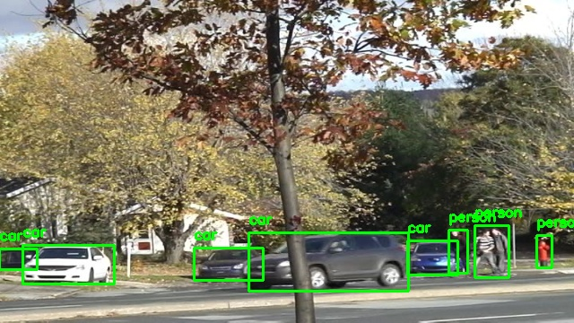
12. Visual Comparison
• Figure 3: YOLO detection on input (missed)

Slide 17
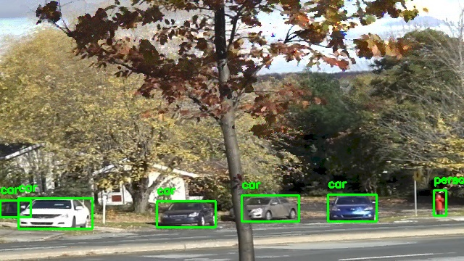
12. Visual Comparison
• Figure 4: YOLO detection on background (detected)

Slide 18
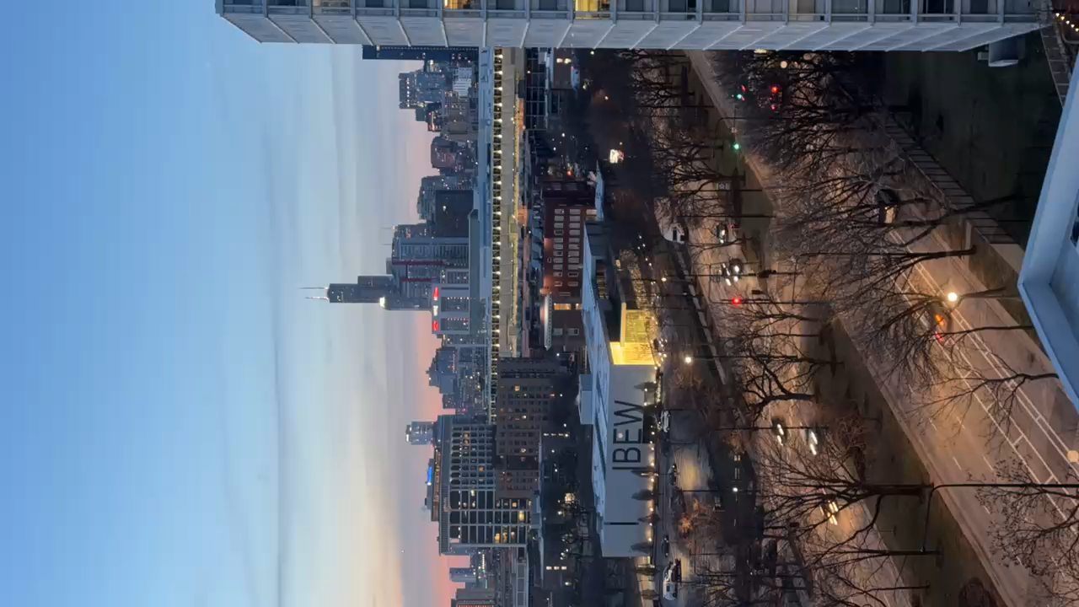
12.Dynamic lighting data

Slide 19
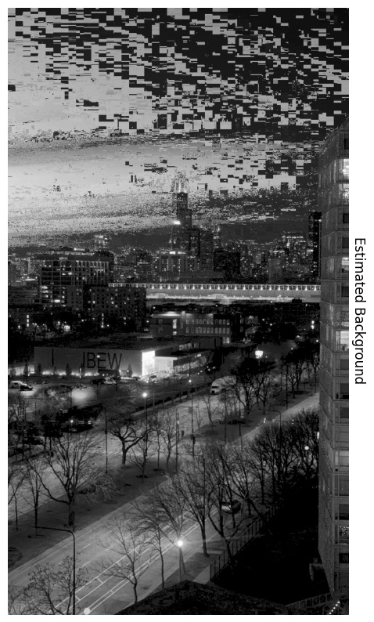
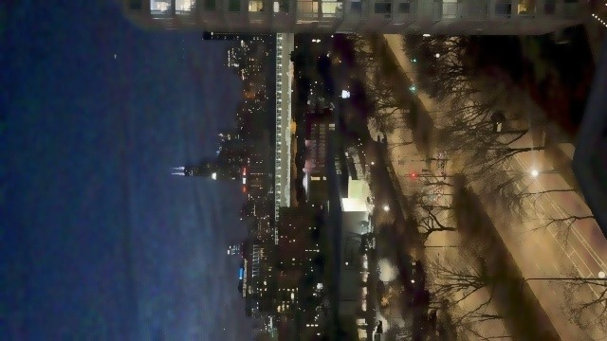
12.Original vs Improved
Original
Improved
As see from the visual comparison our new method shows significant improvement in estimating background in dynamic light conditions.

Slide 20
13. Limitations and Future Work
• Struggles under camera shake or abrupt lighting.
• Cannot handle all forms of shadows or occlusions.
Future Enhancements:
• Optical flow-based stabilization.
• Adaptive entropy thresholding.
• Combine CNN features with histogram background model.

Slide 21
14. Conclusion
The RGB-improved background estimation significantly enhanced object detection accuracy in video sequences.
• Our method reduced undetectable objects and improved F1 scores by up to 20%.
• Background quality (SSIM and PSNR) remained high while maintaining real-time performance (>17 FPS).
• Histogram-based RGB analysis proved robust for static object recognition under diverse conditions.
• The approach is scalable and suitable for practical applications such as surveillance and robotics.

Slide 22
15. References
[1] H.-J. Kim et al., Journal of Web Engineering, 2022.
[2] J. Redmon and A. Farhadi, YOLOv3, arXiv:1804.02767.
[3] CDNet2014 Dataset. http://changedetection.net
[4] OpenCV Documentation
[5] PyTorch Documentation

